Slide 1


UW ENGINE - SPRING 2024
NASA - Jet Propulsion Laboratory Data Science for Scientific Discovery
Chris (Jui-Wei) Chang
Amy (Shiyun) Zhou
Doria (Jiaqi) Dong
Sean Jung
Long Thanh Nguyen
Mazzy Chen
Tung Thanh Dang
University of Washington
Electrical & Computer Engineering
09 MAY 2024

Slide 2
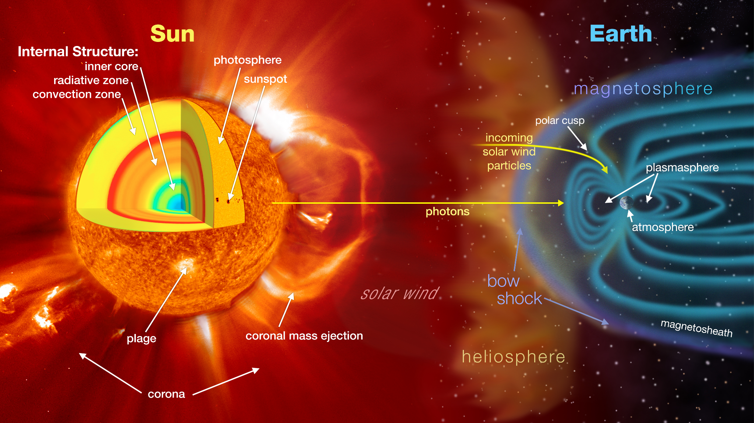
Coronal Mass Ejection (CME) Phenomenon
Source: NASA Scientific Visualization Studio

Slide 3
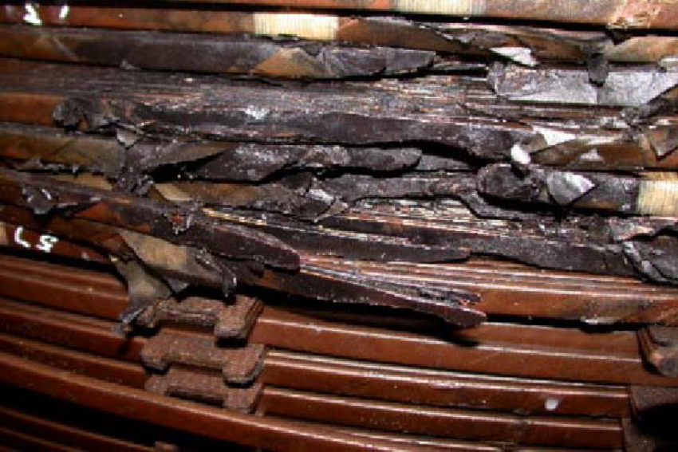
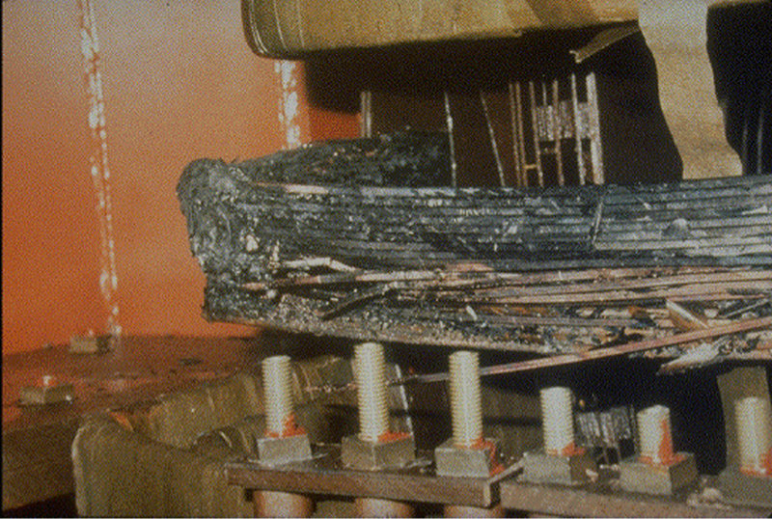
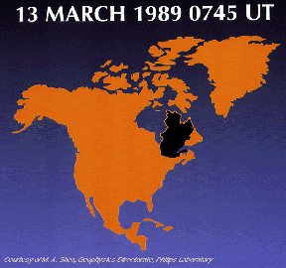
What are Geomagnetic Induced Currents (GIC)?
Transformer Damage & Blackout
October 28-29, 2003
Near South Africa
Transformer Damage & Blackout
March 13, 1989
Quebec, Canada
Notes:
GICs can create great damage into our critical electrical infrastructure, causing power outages that can last for hours and millions of dollars in damage.

Slide 4
Primary Objectives
Create a framework for studying risk and resiliency of a space weather natural hazard on a certain critical infrastructure.
Integrate data from various domains to provide deeper insight on how solar events impact critical infrastructure.
Utilize machine learning models to predict outcomes in various space weather cases and identify subtle underlying connections.
Provide risk and resilience analysis for critical infrastructure such power grid and communications systems through the provided datasets.
Explore the characteristics of space weather impacts on global critical infrastructure; primarily, electrical power grids and communications systems.

Slide 5



UW ENGINE Team and Research Areas
Team Breakdown
Extreme Value Analysis
Chris (Jui-Wei) Chang
Amy (Shiyun) Zhou
Network Analysis
Sean Jung
Doria (Jiaqi) Dong
Machine Learning
Long Thanh Nguyen
Mazzy Chen
Tung Thanh Dang
Primary Datasets:
SuperMAG (1970-present)
Super Magnetospheric Automated Geophysical Observatory (SuperMAG)
Provides global magnetic field observations from multiple international entities, organized by John Hopkins Applied Physics Laboratory.
OMNIWeb NASA (1963-present)
Observations and Measurements of the Interplanetary Medium (OMNI)
Provides interplanetary magnetic field (IMF) data, solar energetic particle (SEP) data, geomagnetic indices, and other field data from spacecraft in geocentric orbit detecting solar winds
NERC GIC (2013-present)
North American Electricity Reliability Corporation (NERC) Geomagnetic Disturbance Incidents (GMD)
Provides geomagnetically induced currents (GICs) on U.S electrical power grid.

Slide 6
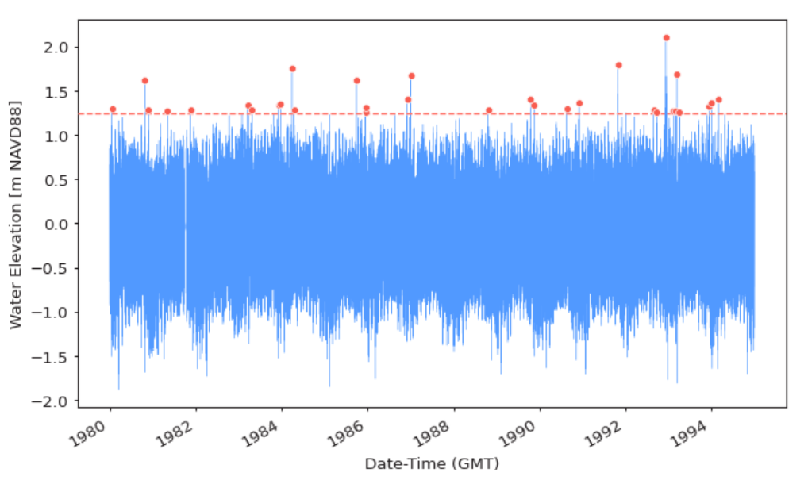
Extreme Value Analysis
Objective:
To analyze extreme values of solar events for forecasting future events.
Approach:
Extract the extreme values of GIC in every station from every events and create a probability distribution curve.
Feed analysis to the machine learning models for forecasting.
In the Next Slides:
Displayed the GIC extreme values by specific solar event, displayed using a colored heatmap.
Presenting prototype of Generalized Extreme Value Distribution (GEV) model
Notes:
Hey this is Chris, Amy and I are in this Extreme Value Analysis sub-team.
Our methodologies include data processing for extracting extreme values, and feeding them into models for risk estimation..

Slide 7
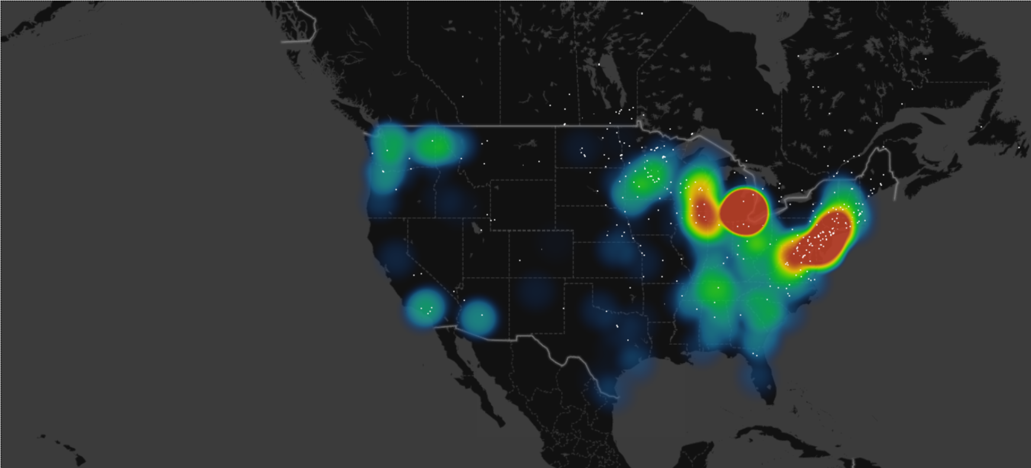
Average GIC extreme values from every events (2013 ~ 2022)
The density of extreme GIC values is concentrated around the East Coast, particularly near Washington, D.C., and in the Michigan area.
Factors:
Power-grid & elec trans line infrastructure
Geology (e.g. Appalachian mountain)
Earth surface impedance
Notes:
This is the slide from the final presentation of last quatuar, We process and visualized the GIC data from NERC on a real USA map to see the location of the hazard.
The results show that most of the severe GIC (the heatmap colored region) occurred around east coast and Milwakee, which is aligned with our other datasets.
Our goal is to integrate the data for ML team for them to take the timeline and coordinates into ML feature

Slide 8
Risk estimation using Generalized Extreme Value Distribution (GEV) model
The GEV model and concept
GEV is useful for predicting the probability of extreme events
Return Level zT: This is the return value of event that happens once in every T years. And we want T to be 100, which is 1-100 years estimation
Threshold exceedances for input data:
Threshold too high => not enough data, high uncertainty . Threshold too low => non extreme data modelled, model not suitable
Notes:
Next we gonna talk about the 1-100 years estimation of GIC. Generalized Extreme value distribution os a method for predicting the probability of extreme events, such as significant weather phenomena for financial market risks.
What we want to estimate is the return value in worse case that happen 1-100 years.
During this process, setting a threshold for the data is a crucial. Because if we set it too high, most data will be filter out and the number of data would not be enough.
But if it is too low, the data would not be extreme enough.

Slide 9
Data constraints in GEV
Extreme values should extract from fixed periods (ex. From each year or each month)
Independency: Every data is independent from any others
Sufficient data: the more data, the more precise the estimation result
Time range should be long enough ( When there are at least 20-30 years of observations)
Abnormal data or Outlier: those data may compromise the model
Time gap between each data should be identical (one data from one year)
Definition of ‘extreme value’ should be clear and specific ( When interested in obtaining estimates for extreme quantities that lie outside the range of the observed data. The variable of interest should be stochastic )
Notes:
This is the data constraints we summarize from slides of Dr Hugo Winter. Including, data independency, time range requirements, and most importantly a clear definition of our extreme values.

Slide 10
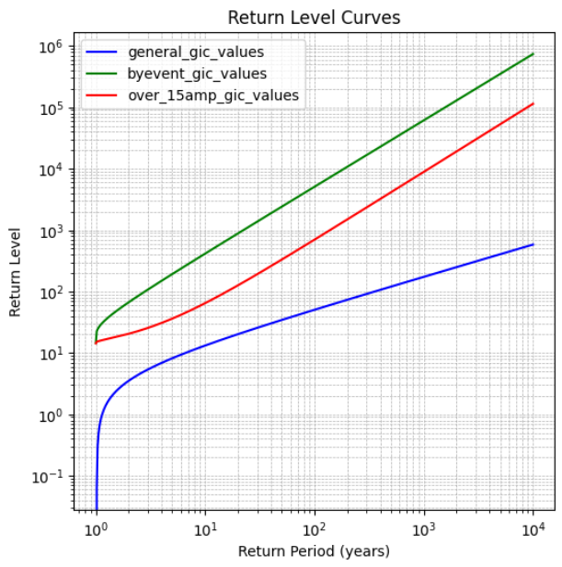
Return level plot for all 3 kinds of methods above
General_gic_values (Includes EV from every event and every stations)
Byevent_gic_values (Extract one EV from each event)
Over_15amp_gic_values (Setting a threshold to filter out low values to make the data more ‘extreme’)
(amp)
5098.62
700.72
50.56
Notes:
This is the visualization of the 1-100 years GIC return level by using GEV, in this pages we use three different condition for the estimation. The blue line symbolizes the general GIC values, we have a 50.56 amp return value. We assume that the reason why it is low is because there are too many low values in the dataset, that’s why we set a threshold exceedance as the redline. We set a threshold value as 15 amp to filter out all the non-extreme values. And the result is 700 amp. Which is more reasonable. As for the green line, we extracted only 1 data from each GIC event, and the result is extremely high, I think it was because the number of data is too small, only 16 of them from in total.

Slide 11
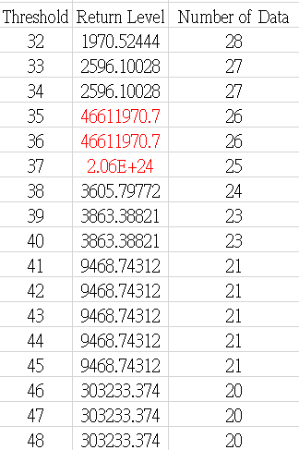
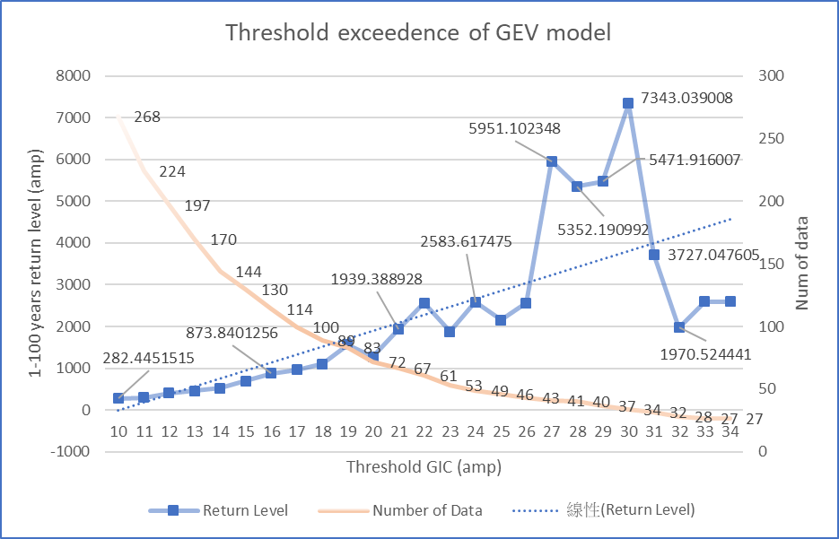
Visualizing GIC EV threshold for GEV return value
Issues : We’re under analyzing and try find out the reasons that cause the abnormal surges
Notes:
This is the visualization of the threshold exeedence for the GEV model, as you can see in the graph the trend of GIC return value is going upward as the threshold going higher. What we try to look into is that there are abnormal surge when the threshold is over 26 amp, we are still under processing of find out the reasons that cause that.

Slide 12
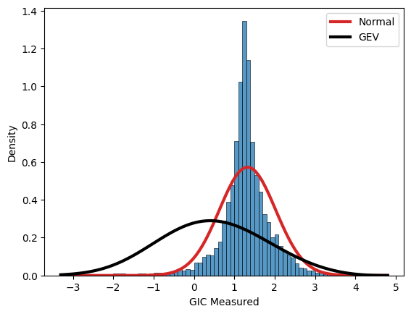
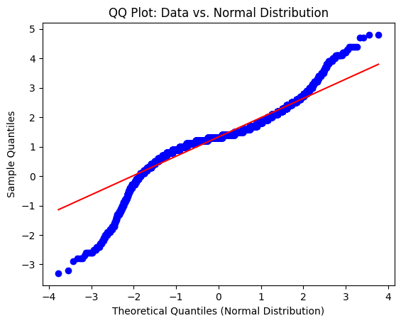
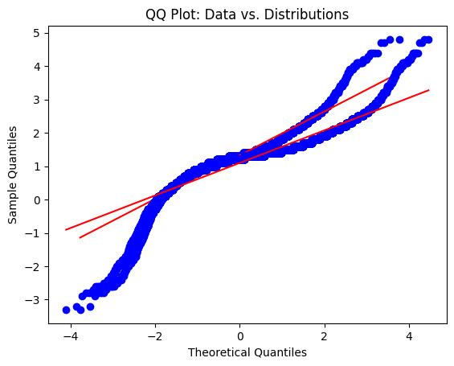
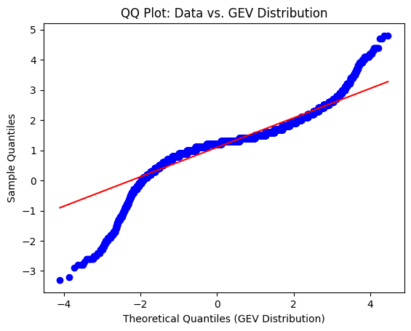
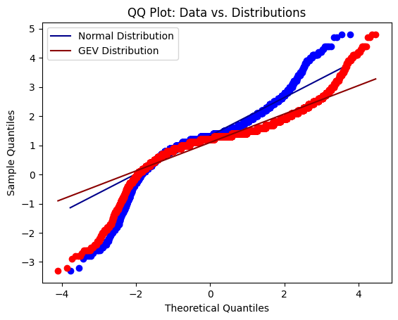
QQ plot
Event 20170527 (Device: 10305) - PDF and QQ Plots for Normal and GEV Distributions
Event 20170527
Device: 10305
(supernode)
Notes:
The DQQ procedure is summarized in Figure 1. Consider two samples of variable X, denoted by time series x1 sampled during a period centered on t1 and series x2 sampled during a period centered on a later time t2. The cumulative distribution function (CDF) gives the probability of observing a value of X less than or equal to x, as a function of x (Figure 1a). It can be determined empirically by ordering the sampled data in increasing size and then plotting the data value against its position in the series normalized by the total number of observation

Slide 13
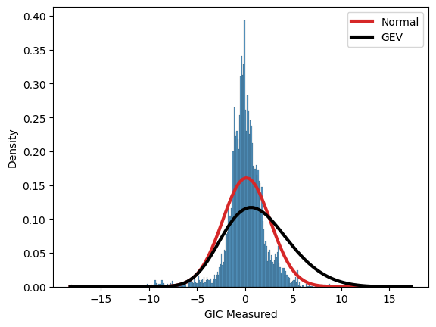
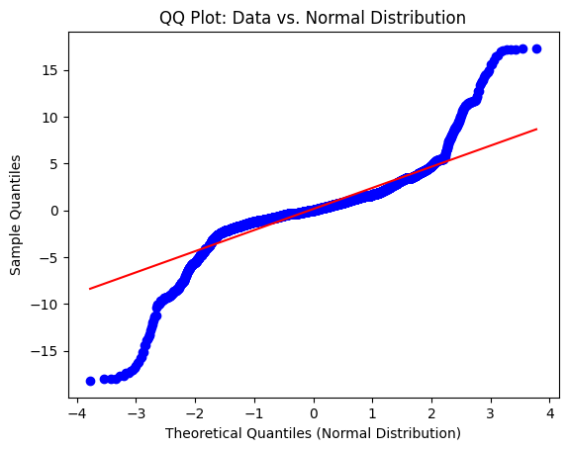
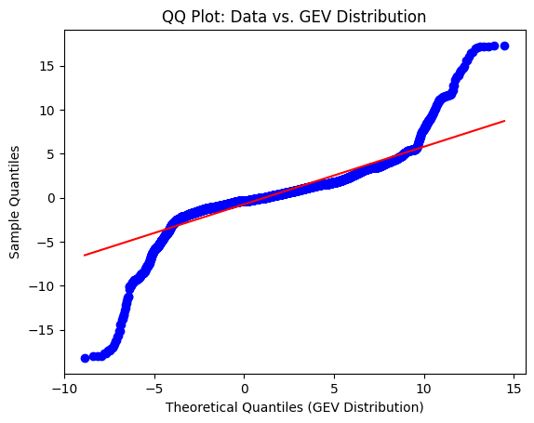
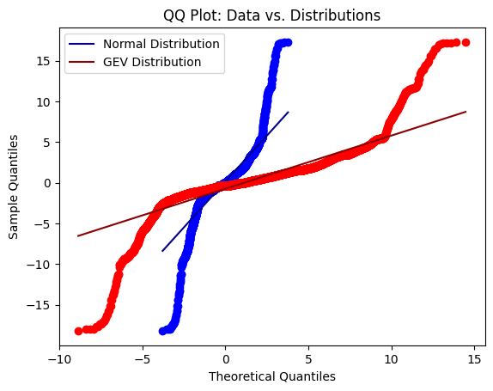
Event 20170527 (Device: 10397) - PDF and QQ Plots for Normal and GEV Distributions

Slide 14
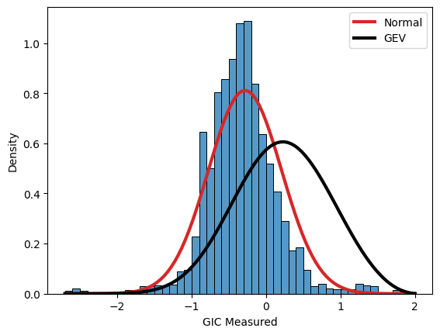
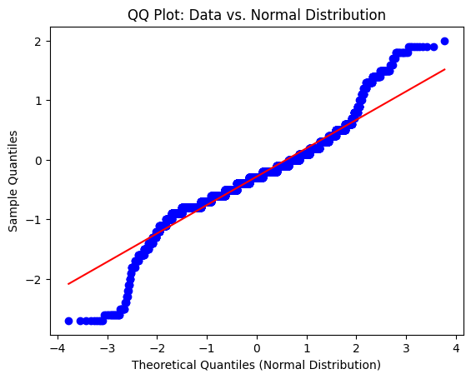
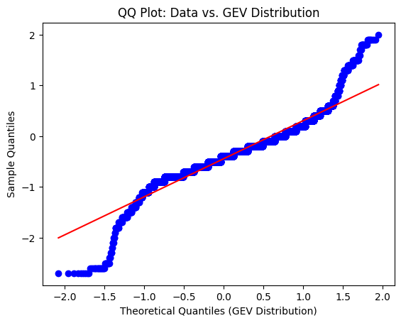
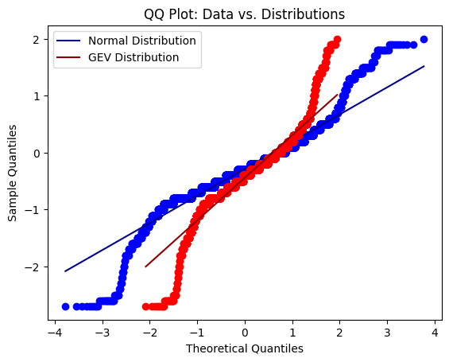
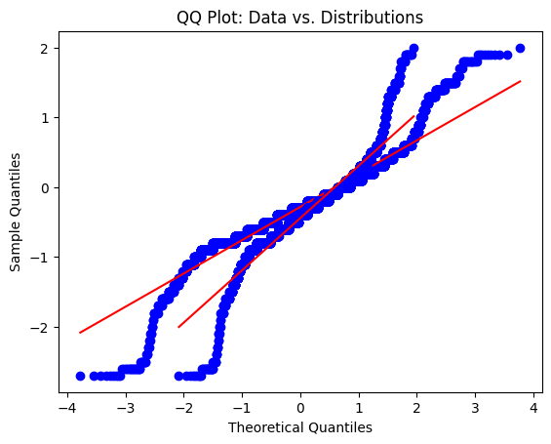
QQ plot
Event 20170527
Device: 10409
(supernode)

Slide 15
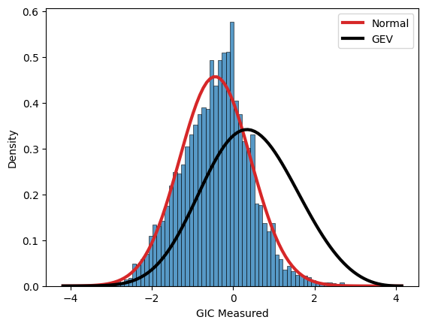
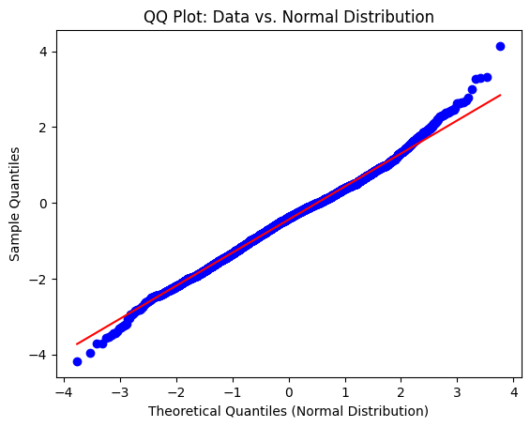
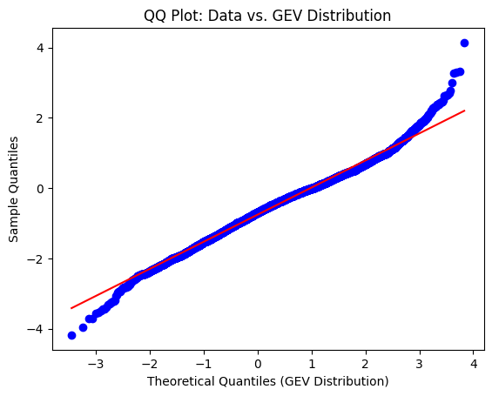
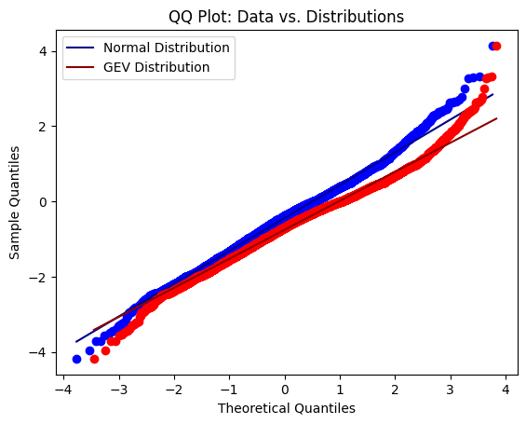
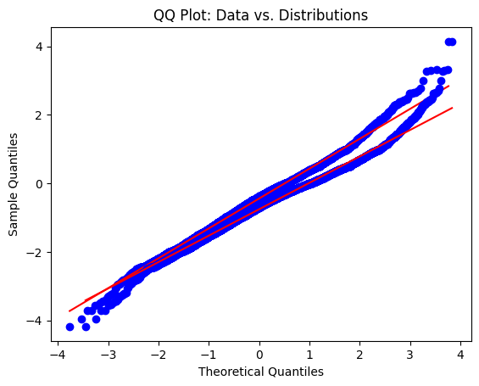
QQ plot
Event 20170527 (Device: 10081) - PDF and QQ Plots for Normal and GEV Distributions
Event 20170527
Device: 10081

Slide 16
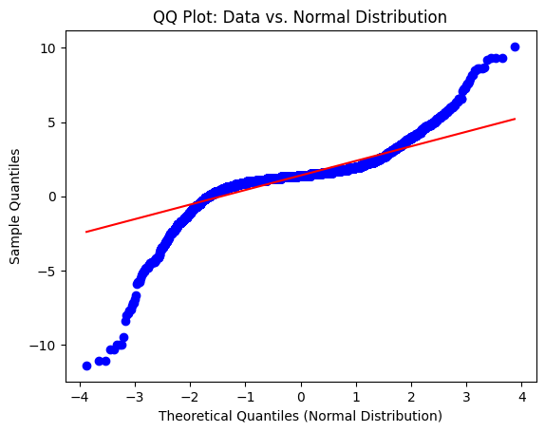
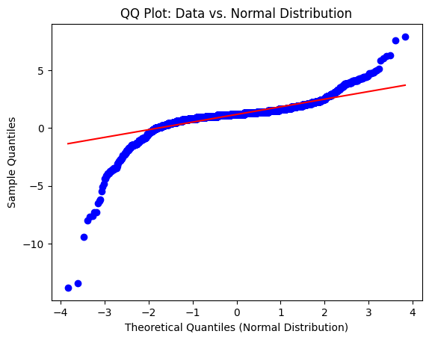
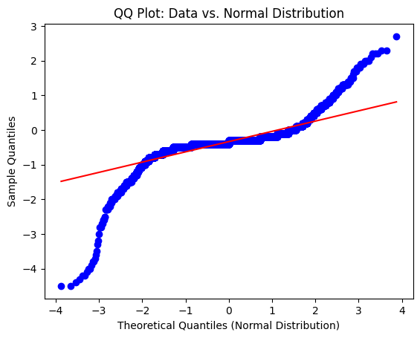
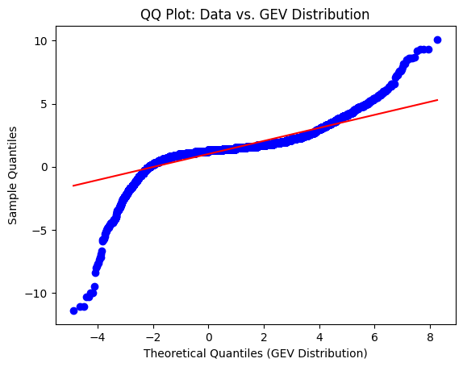
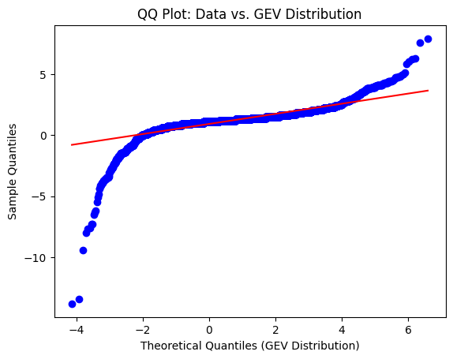
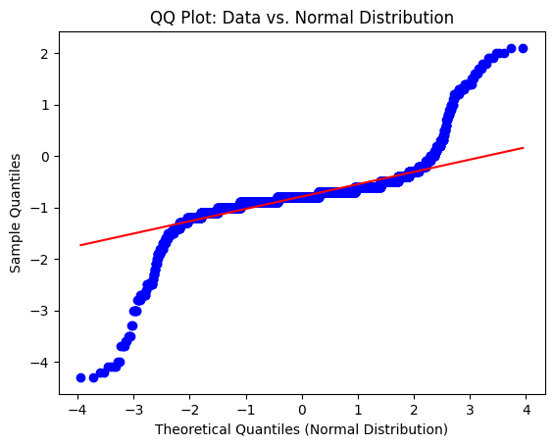
Data & normal distribution
Device: 10305
(supernode)
20150622 20170527 20180825

Slide 17
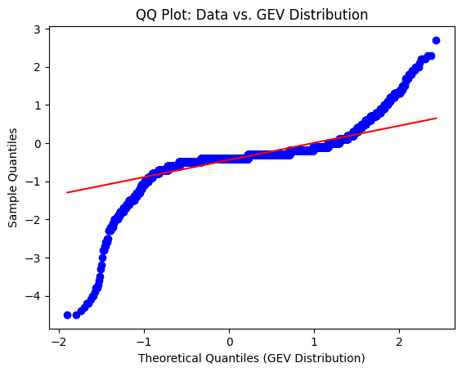
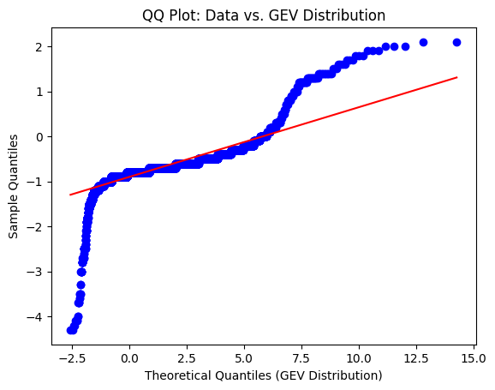
Data & GEV distribution
Device: 10305
(supernode)
20210512 20220409
Notes:
the approximate linearity of each segment indicates that the functional form of the distribution is unchanged throughout these two cycles, while the displacement of each segment from the y = x line signifies a solar cycle dependence in the moments of each component of the distribution.
The DQQ plots for Bx in Figure 4 exhibit a similar departure from the y = x line at |Bx|=8 nT. in Figures 5ci and 5cii the grey region highlights values −8 nT<Bx<8 nT, wherein both traces again lie on top of each other, and here also along the y = x line. The core component in the distribution of Bx therefore shows little sensitivity to the detailed differences across two solar cycles. At values outside of the |Bx|<8 nT region, the DQQ traces deviate from each other and the y = x line, showing the distinct time dynamics of the tail component that is sensitive to changes both within a solar cycle and between cycles 23 and 24. When plotted on linear axes, the DQQ plot naturally highlights the behavior of the extremal tail of the distribution

Slide 18
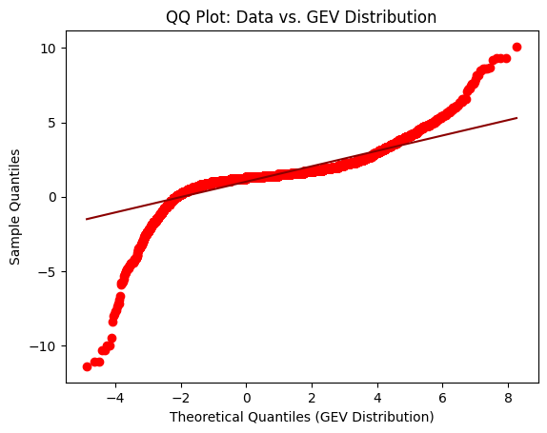
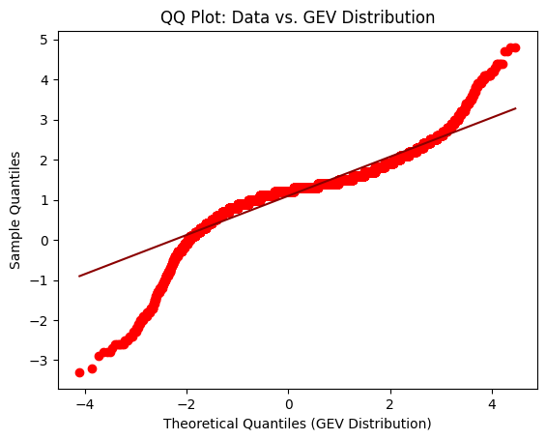
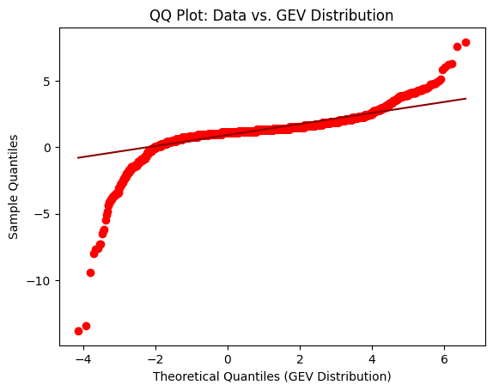
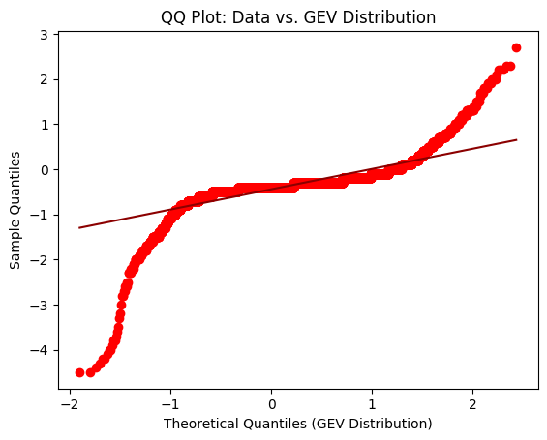
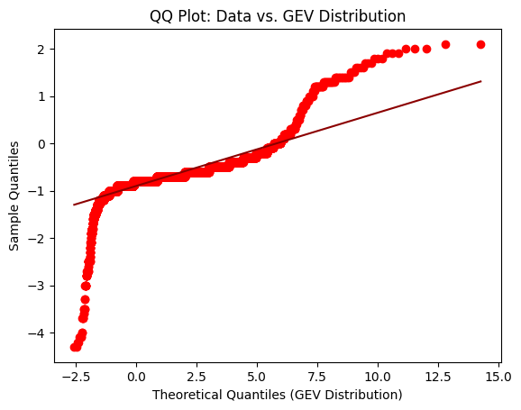
Device 10305 across multiple events (20150622, 20170527, 20180825, 20210512, 20220409) - QQ plots for Normal and GEV distributions
20150622 20170527 20180825 20210512 20220409

Slide 19
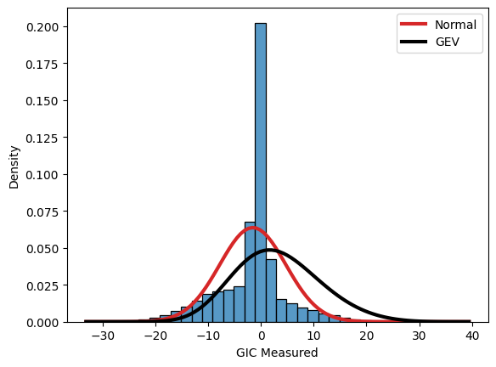
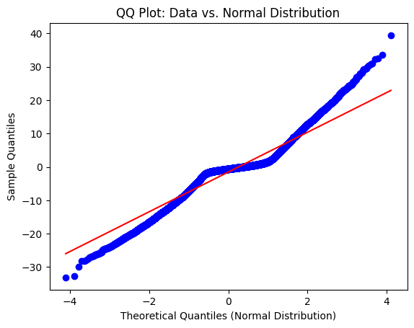
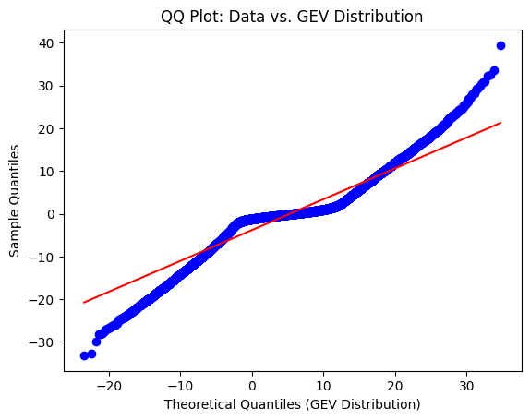
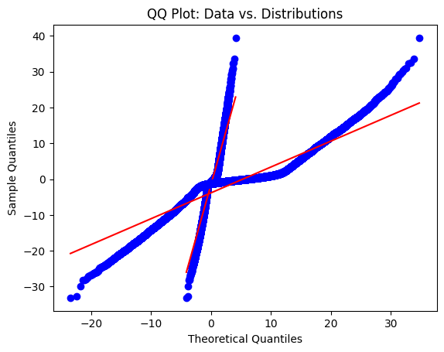
Event 20230423
Device: 10069
(supernode,
41.90, -87.70)
Notes:
the approximate linearity of each segment indicates that the functional form of the distribution is unchanged throughout these two cycles, while the displacement of each segment from the y = x line signifies a solar cycle dependence in the moments of each component of the distribution.
The DQQ plots for Bx in Figure 4 exhibit a similar departure from the y = x line at |Bx|=8 nT. in Figures 5ci and 5cii the grey region highlights values −8 nT<Bx<8 nT, wherein both traces again lie on top of each other, and here also along the y = x line. The core component in the distribution of Bx therefore shows little sensitivity to the detailed differences across two solar cycles. At values outside of the |Bx|<8 nT region, the DQQ traces deviate from each other and the y = x line, showing the distinct time dynamics of the tail component that is sensitive to changes both within a solar cycle and between cycles 23 and 24. When plotted on linear axes, the DQQ plot naturally highlights the behavior of the extremal tail of the distribution

Slide 20
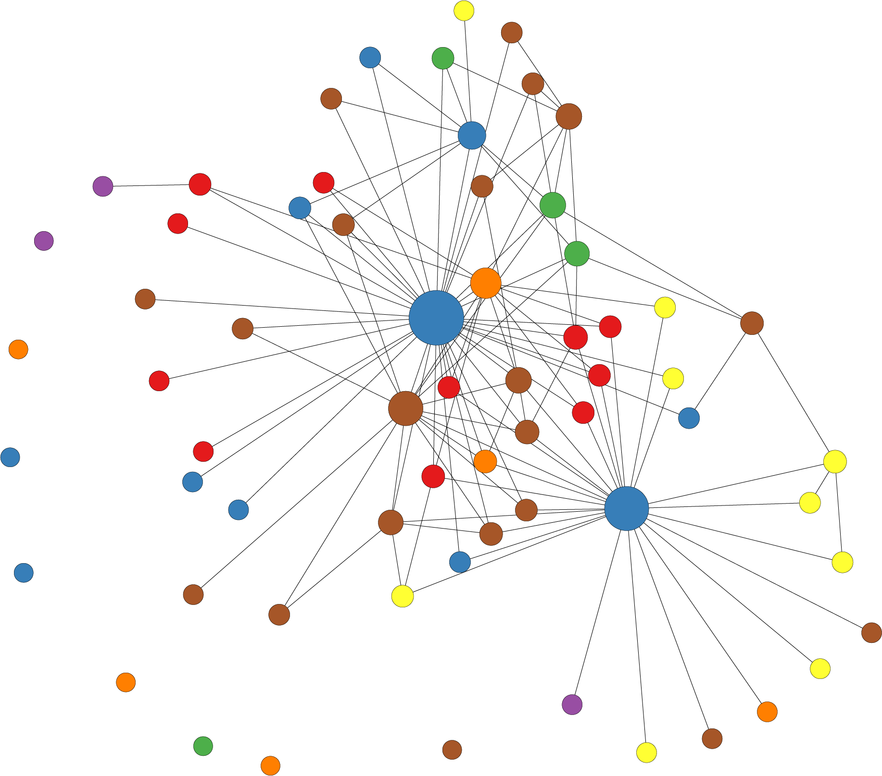
Network Analysis
Objective:
To quantify the magnitude and impact of Geomagnetically Induced Currents (GIC) on U.S power grid.
Approach:
Use wavelet decomposition on GIC data to determine significant changes and correlations.
Create a nodal network based on correlations.

Slide 21
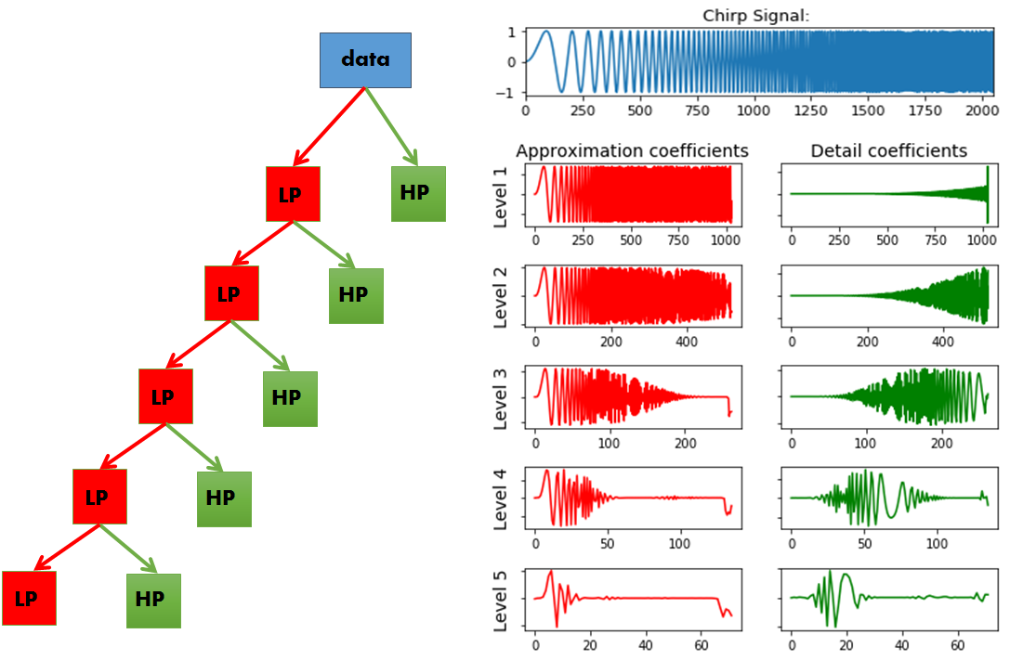
Wavelet Decomposition
Step 1: Data Preprocessing is aligned with the time scale
Loaded the raw GIC data (NERC) and resampled data to align time scales.
Step 2: Perform the wavelet transform (Discrete/Stationary Wavelet Transform)
Extract coefficients for each GIC monitor (per event) visualized via heat map.
Step 3: Find correlation between wavelet coefficients of each station.
Utilized sliding window method for finding correlation.

Slide 22
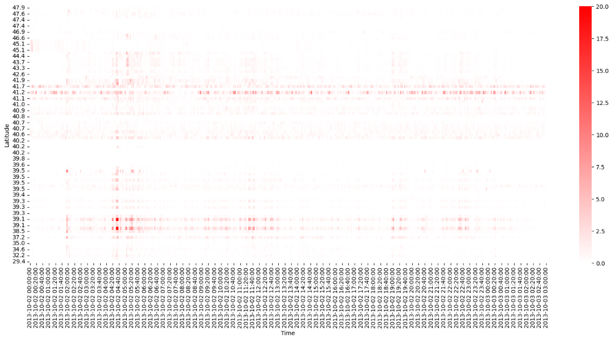
Step 1: Perform the wavelet transform on the preprocessed GIC data
Event: 2013 October 02 by Latitude

Slide 23
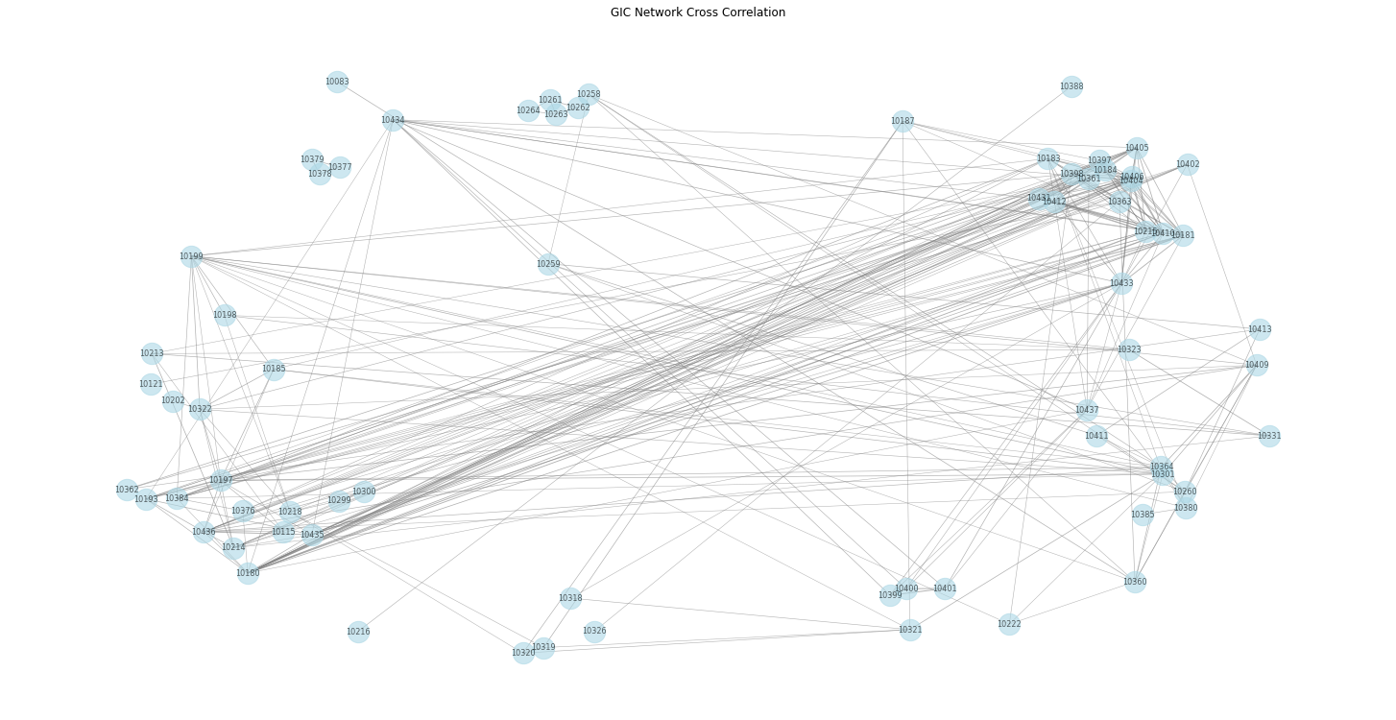
GIC Cross-Correlation Results by Device ID (threshold = 0.5)
Step 2: Using wavelet coefficients find correlation between each station.
Event: 2013 October 02 by Latitude

Slide 24
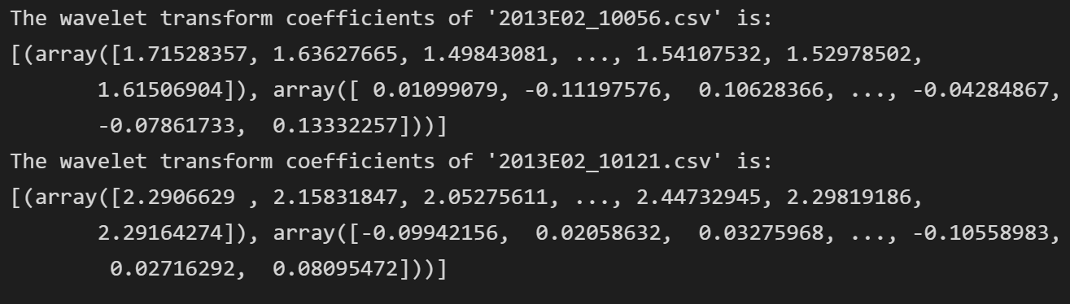

Sliding-window cross-correlation
Step 2: Using wavelet coefficients find correlation between each station.
Station 1
—----------
Station 2
The color plots the magnitude of the correlation.
it will be presented only when the correlation of the node must both
(i) exceed 80% of all values obtained at that node and
(ii) the wavelet cross-correlation between a pair of nodes must exceed 0.85 within a 30-minute leading edge window, otherwise it will show a circle with no color.
Event: 2013 October 02 by Latitude

Slide 25




Step 3: Optimize the threshold of each monitor
Aim: Find a specific threshold CTi for each monitor so that the calculated average degree of each site is equal to the normalization degree n0.
Cij(t) is the correlation between site i and site j at time t
CT is the global threshold
Average degree ni(CT) at different global threshold CT values.

Slide 26




Step 3: Optimize the threshold of each monitor
Average degree
Threshold Station 68 Station 54 Station 70 Station 82 Station 63

Slide 27


Device Specific Correlation Timelapse (2013 Oct 02)
with eigenvector centrality measures (size of red nodes)

Slide 28
Auroral Ejection Index Event: 2013 Oct 02
AU = High Latitude
—-------------------
AL = Near equator
Asymmetry Index
ASY-D = East/West
ASY-H = North/South
NOTE: ASY-D & ASY-H represents the asymmetric disturbance component of the auroral electrojet currents. ASY-D changes in the east-west component of the auroral electrojet current system and ASY-H represents primarily related to changes in the north-south component.
SYM-H is the measure of geomagnetic activity that represents the symmetrical disturbance of the Earth’s magnetic field.
Source: WDC for Geomagnetism, Kyoto AE Index

Slide 29
Comparison
Event: 20131002
Auroral Ejection
Index
Wavelet Decomposition

Slide 30

Major US Transmission Lines (Physical Grid)
k
kV
Source: Climate Mapping for Resilience & Adaptation - Esri U.S Federal Datasets

Slide 31


Slide 32


Slide 33


Slide 34


Slide 35


Slide 36


Slide 37


Slide 38
Machine Learning
Objective:
Predicting and forecasting (Geomagnetically Induced Currents) GICs to mitigate the impact on the critical infrastructure through developing nowcast and predictive models for SuperMAG (dB/dt) and NERC GIC variables by exploring the most meaningful ML algorithms.
Approach:
Consolidate raw from datasources: SuperMAG, OMNI and NERC GIC data.
Create analysis-ready datasets for magnetic perturbation prediction & NERC GIC values.
Preprocess dataset and feature engineering for training and testing purposes.
Experimenting with the following ML models:
Multivariate Linear Regression
Random Forest Regressor
LSTM(with Attention)/GRU

Slide 39
Data Flow for Magnetic Perturbation Prediction
API
Google Drive
Google Drive
Folder: data/SuperMAG/clean/
Folder: data/ML/
- Resampled to 5-min cadence.
- Missing values filled with mean interpolation.
- Separated into years file
SuperMAG
(2010-2023)
.csv
- Has total of 17 fields:
- 9 fields from SuperMAG data
- 8 fields from OMNI data
- Each .csv file contains data for one year
- Each file is about 3.5-4.0GB
Preprocessing Data Process
Dataset Creation Process
.csv
Folder: data/OMNI/clean/
OMNI
(2010-2023)
- Resampled to 5-min cadence.
- Missing values filled with mean interpolation, backward and forward values.
.csv
+ datetime
+ glon
+ glat
+ mlon
+ mlat
+ mlt
+ dbn_nez
+ dbe_nez
SuperMAG
OMNI
Filling missing and replace default values
Retrieve Data
Filling Missing Values
Resample to 5-min cadance
+ datetime
+ BX, BY, BZ (GSM)
+ flow_speed
+ proton_density
+ T
+ Pressure
+ Clock angle IMF

Slide 40

Multivariate Linear Regression
Dataset:
Features: glon, glat, mlon, mlat, mlt, BX_GSE, BY_GSM, BZ_GSM, flow_speed, proton_density, T, Pressure, SYM_H, CLOCK_ANGLE_GSM, ut_sin, ut_cos, day_sin, day_cos
Target: dbn_nez, dbe_nez
Current Experiment Result:
RMSE (Root Mean Square Error) | dbn_nez: 8.2581378736, dbe_nez: 6.5328766099
MAE (Mean Absolute Error) | dbn_nez: 5.76408362, dbe_nez: 4.44876215
y-intercept | [4.50313219, -1.8351527]
slope

Slide 41


Result Graph (1 station)

Slide 42

Kernel Density Plot

Slide 43
Random Forest Regressor
Hyperparameter:
max_depth=90, max_features=0.5, min_samples_leaf=8, min_samples_split=5, n_estimators=911
Metrics Results:
MSE (Mean Square Error) | dbn_nez: 7.72851167, dbe_nez: 5.87643097
MAE (Mean Absolute Error) | dbn_nez: 5.45354611, dbe_nez: 4.05777287

Slide 44

Random Forest Regressor

Slide 45

Kernel Density Plot (Random Forest)

Slide 46
















Hyperparameters Surface Plots

Slide 47
Long-Short Term Memory (LSTM) Model
Dataset:
Region:
glon:76.920, glat:43.250
Time:
Training set: Data of 2010 to 2019(70%)
Validation set: Data of 2020 to 2022(20%)
Testing set: Data of 2023(10%)
Current Result:
Configuration:
360 batches, 0.001 learning rate, ReLu activation, ADAM optimizer, MSE loss, 50 epochs

Slide 48




LSTM
(glon:76.920, glat:43.250)
2020- 2023 | dbn | dbe
RMSE | 1.620 | 1.288
MAE | 0.935 | 0.757
2023.4.23-2023.4.24 | dbn | dbe
RMSE | 7.013 | 6.900
MAE | 4.071 | 3.345

Slide 49
Data Flow for GICs Prediction
Google Drive
data/ML/
API
Folder: data/NERC/FinalGIC.csv
- Will only use SuperMag data in this dataset
NERC GIC
(2013-2023)
Preprocessing Data Process
.csv
.csv
- Resampled to 5-min cadence.
+ datetime
+ glon
+ glat
+ mlon
+ mlat
+ mlt
+ dbn_nez
+ dbe_nez
+ datetime
+ GICMeasured
+ Longitute
+ Latitude
NERC GIC
Super-Mag
i
Google Drive
data/ML/NERC_GIC/Dataset
.csv
Containing Datasets ready from 2013-2023
We joining the 2 dataframe by datetime and Locations
.csv
.csv
Notes:
s

Slide 50

Devices and Stations Mapping
Station(Center): (38.5, 263.7)
Devices(around):
{(34.1, 206.8), (32.6, 262.8), (31.4, 264.6), (34.9, 270), (35.3, 270.2), (36.2, 271.2), …}

Slide 51

Train and Test Datasets split
Training Datasets
Test Datasets

Slide 52
Multivariate Linear Regression for GIC
Dataset:
Features: datetime , mlon, mlat, mlt, dbn_nez, dbe_nez
Target: GICMeasured
Current Experiment Result:
Mean Square Error(MSE) | 4.08974801
Mean Absolute Error(MAE) | 2.08750422

Slide 53


Result Graph

Slide 54


Kernel Density Plot

Slide 55
Random Forest Model for GIC
Hyperparameter: n_estimators=100, max_depth=30, random_state=2
Mean Square Error(MSE) | 5.82316737
Mean Absolute Error(MAE) | 2.31942044

Slide 56
End

